Slide 1
To Frontalize Or Not To Frontalize: Do We Really Need Elaborate Pre-Processing To Improve Face Recognition?
James Yost & Matthew Ernst

Slide 2
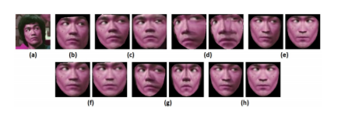
Overview
Questions:
Does training CNNs with frontalized images yield better results, or can they learn robust representations invariant of facial pose on their own?
Example:
Iphone face recognition
Notes:
What are they doing?
Why they chose this?
Usefulness?
Applications in field
(a) from the CASIA-WebFace dataset [51]:
(b) 2D aligned – no frontalization,
(c) Zhu and Ramanan [55] & Hassner et al. [15],
(d) Kazemi and Sullivan [23] & Hassner et al.,
(e) CMR & our frontalization method (OFM),
(f) CMR & Hassner et al. [15],
(g) Zhu and Ramanan [55] & OFM, and
(h) Kazemi and Sullivan [23]

Slide 3
Chosen Landmarking & Frontalization Methods
Images Used:
CASIA-WebFace (CW)
Landmarking methods:
Zhu and Ramanan (ZR)
Kazemi and Sullivan (KS)
Cascade Mixture of Regressors (CMR)
Frontalization methods:
Hassner et al. (H)
Our Frontalization Method (OFM)
Notes:
For this study, we used the CASIA-WebFace (CW) [51] dataset for CNN training.
Zhu and Ramanan (ZR)
Kazemi and Sullivan (KS)
Cascade Mixture of REgressors (CMR)
Hassner et al

Slide 4
Zhu and Ramanan (ZR)
Pros
Simultaneous Face Detection
Pose Detection
Accommodating Up To 175 Degrees of Facial Yaw
Cons
Relatively Slow
Why Chosen
Optimizes Tree Structure With Maximum Likelihood Calculations
Notes:
The ZR method allows for simultaneous face detection, landmarking, and pose detection, accommodating up to 175 degrees of facial yaw. ZR uses a mixture of trees approach, similar to that of phylogenetic inference. The algorithm proposed in [26] is used to optimize the tree structure with maximum likelihood calculations based on training priors. Due to the algorithm performing localization and landmarking concurrently, it is relatively slow.

Slide 5
Kazemi and Sullivan (KS)
Pros
Small Subset of Pixels From Image
High Level Accuracy
Ease of Use
Why Chosen
Widely Used
Notes:
KS uses a cascade of multiple regressors to estimate landmark points on the face using only a small, sparse subset of pixel intensities from the image. This unique sub-sampling renders it extremely fast, while maintaining a high level of accuracy. This land- marker is popular due to its ease of use and availability — it is implemented in the widely used Dlib library [25].

Slide 6
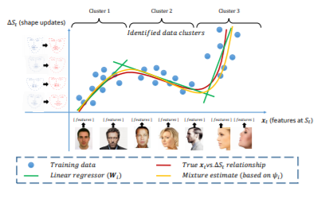
Cascade Mixture of Regressors (CMR)
Pros
Fast
Simultaneous Updating
Mixture Based Landmarking
Why Chosen
Balance Between Accuracy and Speed

Slide 7
Hassner
Pros
Allows 2D Face Images Frontalized Without 3D Knowledge
Open Source
Cons
Can Have Stretch and Distorted Frontalized Face
Why Chosen
Prominence In Facial Biometrics
Notes:
This method allows 2D face images to be frontalized without any prior 3D knowledge. We chose to analyze this method due to its prominence in the facial biometrics community, and because an open source implementation of the algorithm exists. Using a set of reference 3D facial landmark points determined by a 3D template, the 2D facial landmarks detected in an input image are projected into the 3D space. A 3D camera homography is then estimated between them. Back-projection is subsequently applied to map pixel intensities from the original face onto the canonical, frontal template. Optional soft symmetry can be applied by replacing areas of the face that are self-occluded with corresponding patches from the other side. Due to the global projection of this method, incorrect landmarking can stretch and distort the frontalized face, causing loss of high-frequency features used for matching.

Slide 8
Papers Method: Our Frontalization Method (OFM)
Overview:
Frontalization procedure capable of synthesizing a frontalized face image from an arbitrary facial orientation.
Notes:
proposed frontalization procedure, which is capable of synthesizing a frontalized face image from a single input image with arbitrary facial orientation without requiring a subject-specific 3D model.

Slide 9
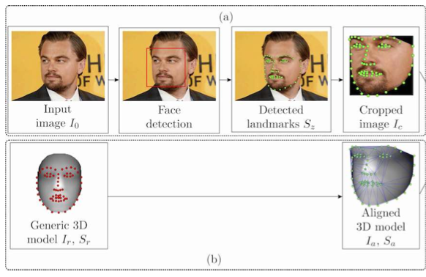
Our Frontalization Method (OFM): Face Detection, Landmarking & Model Fitting
Viola-Jones Face Detector
CMR For Landmarking
Pose
Orientation
Transform Image to Frontal Pose
Depth Estimate of Pixels
Generic 3D Face Model
Delaunay Triangulation
Provides Rough Estimate of True Values
Notes:
The landmarks can be used to determine the pose and orientation of the processed face. We crop the facial area, Ic, based on the detected landmarks and use it as the basis for frontalization
We fit the 3D model to the cropped image through a piece-wise warping procedure guided by the Delaunay triangulation of the annotated landmarks. Since the annotated landmarks reside in a 3D space
generated by the warping procedure represents only a rough estimate of the true values, but as we show later, is sufficient to produce visually convincing frontalization results.

Slide 10
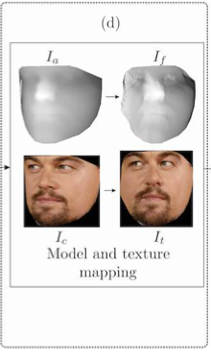
Our Frontalization Method (OFM): 3D Transformation & Texture Mapping
Transformation
After fitting the corresponding landmarks from aligned and generic model to estimate 3D transformation. (Maps back to frontal)
Horn’s Quaternion used to calculate scaling, rotation and translation.
Texture Mapping
Original cropped image and aligned image defined over a same XY-grid.
From overlap 2D-to-3D can be exploited to map texture from the cropped image to the newly texture image.
Interpolation is used to fill in missing values
Transformed & Textured Image is Initial Frontal Image

Slide 11
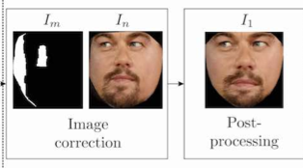
Our Frontalization Method (OFM): Image Correction & Post Processing
Image Correction
Triangulation performed on input face landmark coordinates
Each triangle mapped to generic model through affine transforms.
From warping, minor distorted and occluded areas are added to the image
Post Processing
By analyzing the aligned and frontal image a mapping equation is made
If a certain pixel falls below a threshold a symmetrical mapping is made.
The corrected image is mapped to a mean image to account for uniformity.
All facial features properly aligned

Slide 12
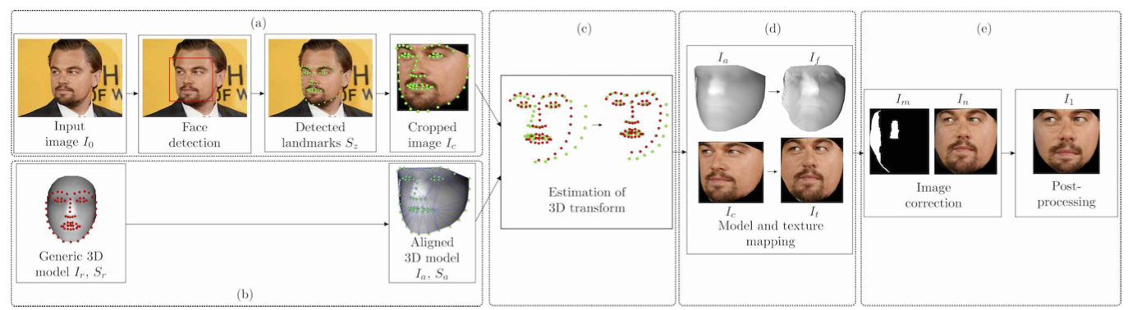

Slide 13
Data Sets
Training Data: CASIA-WebFace:
Used a subset containing 303,481 images from a total 7577
Test Data: PaSC :
a collection of videos acquired at the University of Notre Dame over seven weeks in the Spring semester of 2011.
consists of video sequences physically collected specifically for face recognition tasks.
Frontalization Yield Data set: MultiPIE
To evaluate the success rate of each landmarker and frontalizer combination at specific facial pose angles (yaw).

Slide 14
CNN Architecture
CNN architecture : VGG-FACE
Why?
it generates verification results comparable to Google FaceNet on LFW while requiring a fraction of its training data.
the model performs reasonably well on popular face recognition benchmark
A snapshot of this model, pre-trained with 2.6 million face images, is present in the Caffe model zoo
Notes:
Interesting note, CW had 494,414 images with 10,575 people, and an average of 46 images per person. The now have an average of 40 per person
They used this pre-trained model to fine-tune connection weights in our training experiments for faster convergence.

Slide 15
Pre-
processing Methods
Pre-processing Methods
Different combinations of the landmarkers and fronalizers.
ZR & H
KS & H
CMR & OFM
CMR & H
ZR & OFM
KS & OFM
Three baseline approaches
2D alligend CW images rotated using eye centers (found from KS)
No pre-processing
A snapshot of the original VGG-FACE model, pre-trained on 2.6 million 2D aligned face images from the VGG-FACE dataset, as a comparison against a prevalent CNN model

Slide 16
Feature Extraction and Scoring
Before Extraction:
They removed bad facial detections by calculating the average local track trajectory for a rough estimate of neighboring detections and removing any coordinates outside of 2.5𝝈
Extraction:
Frame Feature:
4096 dimensional vector that was extracted from layer fc7 for every face given a CNN model
Video Feature
The N dimensional vector that was created by summing up all Frame Features
Scoring:
Cosine Similarity to compute match scores between feature vectors of different videos
were used for calculating verification and identification accuracy rates of each CNN

Slide 17
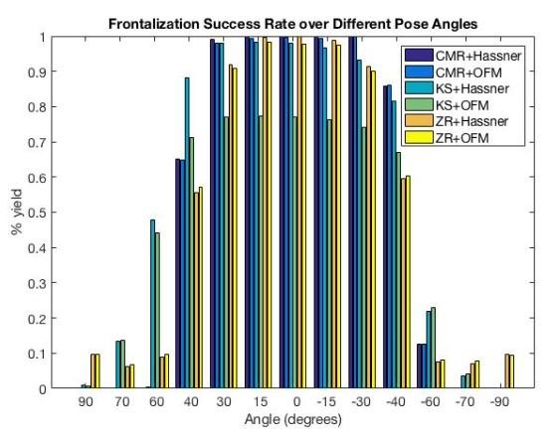
Yield & Results
Frontalization compared to 2D alignment experiences higher failure rates
Landmarker failed to locate all points needed
Incorrectly localize points
Usually due to extreme pose (> 45° yaw) or occlusion
To see operational ranges the Multi-PIE dataset was used
Frontalized dataset images with all six frontalization techniques
(ZR & H, KS & H, CMR & OFM, CMR & H, ZR & OFM and KS & OFM)
Best Landmarking between 0 - 40° with CMR
Notes:
Compared to simple 2D alignment, face frontalization often experiences higher failure rates with decreased operational ranges. For instance, a landmarker may have failed to detect the 68 points needed for frontalization due to extreme pose and terminate before the frontalization step. Conversely, a landmarker could have detected all needed points, but incorrectly localized just one or two, leading to an in- valid 3D transform matrix in frontalization. These type of cascading failures lead to many samples in CW and PaSC to fail in the landmarking or frontalization step due to extreme scale, pose (> 45◦ yaw), or occlusion. Hence each pre-processing method yields a unique subset of frontalizable images well below the total original number.
To better understand the operational ranges of each scheme, we frontalized face images from the multi-view partition of the Multi-PIE dataset [13]. All six frontalization techniques (ZR & H, KS & H, CMR & OFM, CMR & H, ZR & OFM and KS & OFM) were tested for each pose in the dataset, including differing expressions and illumination. The pose angles tested were binned into subsets of 0◦, 15◦ , 30◦ , 40◦ , 60◦ , 70◦ and 90◦ , along with respective negative angles, using the included labeling from [13]. Failures from landmarking steps or from frontalization steps were not differentiated.

Slide 18
Methodology
Used random 90% of CW for training and 10% for validation
Trained on NVIDIA Titan X GPU using caffe.
Weights were initialized from a snapshot of VGG_FACE pre-trained on 2 million face images
Hyperparameters were selected using HyperOpt and were constant across preprocessing methods
For each frontalization two pre processed versions were kept, symmetric and asymmetric

Slide 19
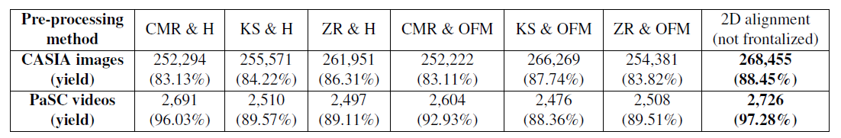
Yield On Testing Data
Two Different methods:
Pre processed method -> Pre processed method
All Pre processed method used
Since the yield of each method was different, the number of PaSC videos varied for each method in the 1st pipeline.
In the 2nd pipeline, all the networks were tested on their congruent pre-processed versions of the same 2267 (out of 2802) PaSC videos.
Notes:
Frames successfully pre proceed by a method were used to test the network trained on CW pre processed imaged with the same scheme
2) the intersection of all PaSC videos successfully pre-processed by all methods was used for testing.

Slide 20
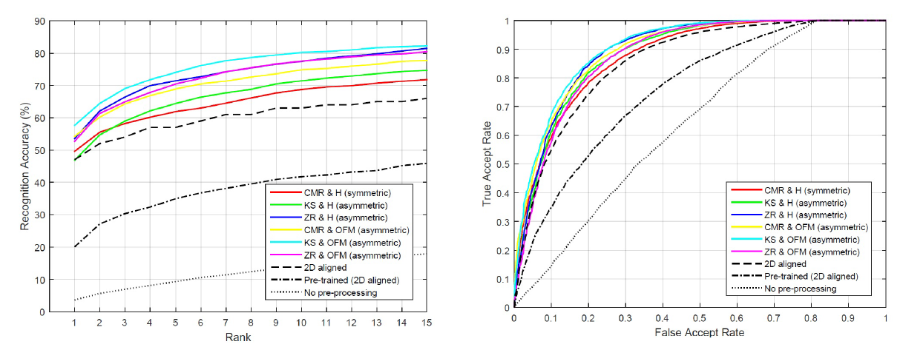
Results of Recognition Experiments
Pipeline 1

Slide 21
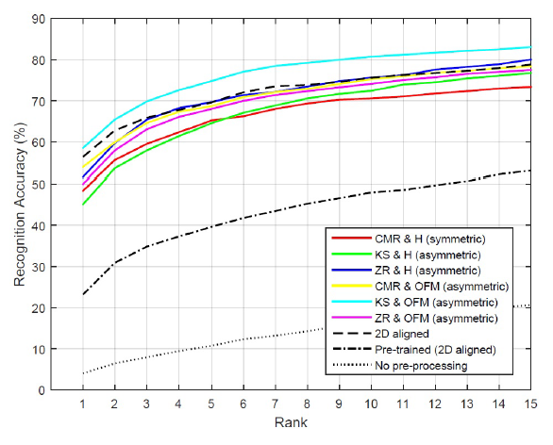
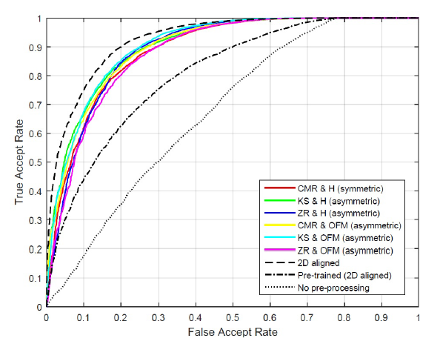
Results of Recognition Experiments
Pipeline 2 subset of 1070 videos

Slide 22
Conclusion
Frontalization in pre-processing is costly.
Extreme pose and occlusion images can cause significant loss in data
Performance must be weighed against computational resources
OFM provides better performance than Hassner
Training and testing data must be preprocessed for performance increases
Asymmetrical faces are recognized more often than symmetrical
Notes:
1) Frontalization is a complex pre-processing step, meaning it can come at a cost. Due to the large number of failure modes it introduces, there can be significant loss of data, i.e. lower yield, specifically with images containing extreme pose or occlusion. Additionally, frontalization can prove to be computationally expensive, meaning the performance benefit frontalization can provide must be weighed against the needed increase in computational resources.
2) Our proposed method, which dynamically adapts local areas of the 3D reference model to the given input face, provides better performance improvements than that of Hassner et al. [15] for PaSC video recognition.
3) Both the training and testing data must be pre-processed under consistent methods to realize any performance benefit out of frontalization.
4) While symmetrically reconstructed frontalized faces may yield more visually appealing results, asymmetrical frontal- ization provides slightly superior performance for face recognition.

